Slide 1


LOAN APPROVAL PREDICTION
SCH-MGMT 661: Appl/Artificial Intel Business
Section -2 - Group 03
Marik Gesin
Mohammad Nowas
Prajwal Kumar Hemmakki Rathnakar

Slide 2
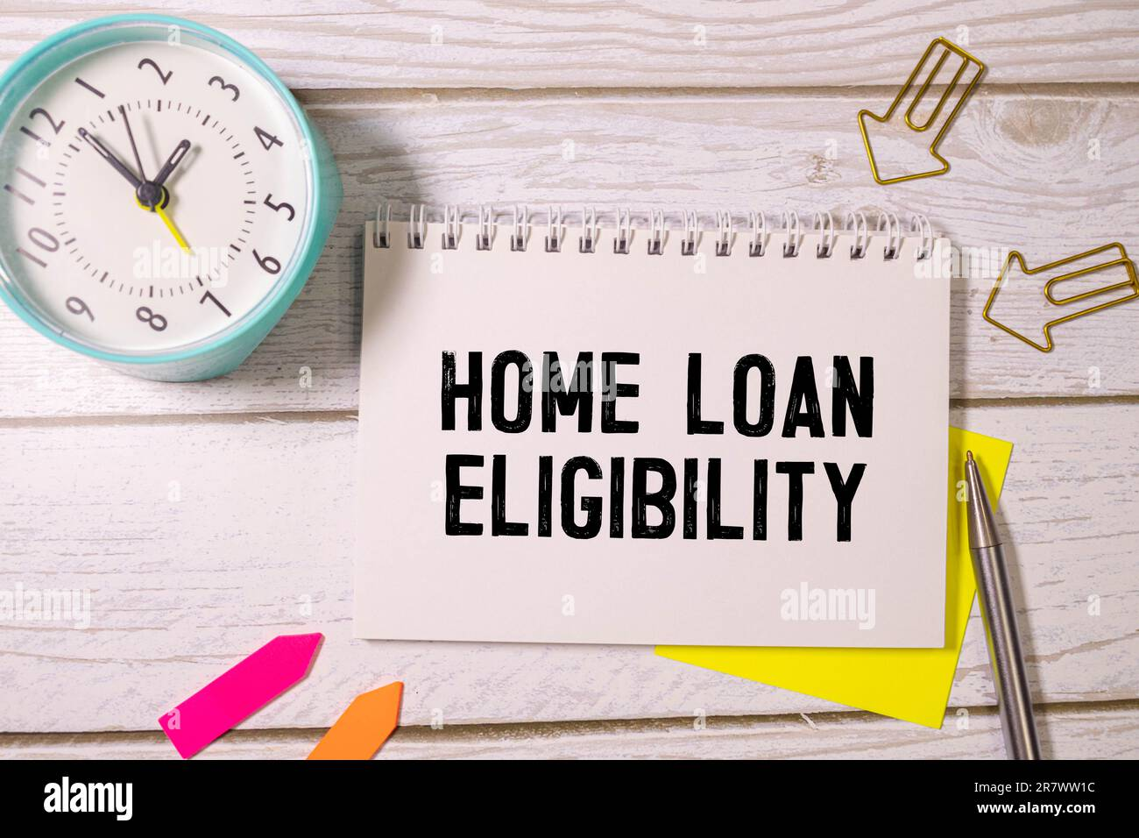

Agenda:
Objective
Data Dictionary
Importing and Cleansing Data
How the Code Works Colab Demonstration
Business Benefits
Ethics of AI
Project Roles
Real Project Implementation
Results – Three Models Untuned and Tuned
Conclusion
Recommendations

Slide 3

Objective:
Problem: Manually assessing loan eligibility can be often time-consuming and also at times be subjective. Solution: We propose leveraging machine learning to automate loan approval predictions.
Explore and comprehend the diverse elements shaping the loan approval procedures.
Harness the power of past customer information to develop a predictive framework capable of gauging the probability of loan approval..

Slide 4
Data Dictionary:
The data contains both Numerical and Categorical attributes:
Categorical
ApplicantIncome: The income of the applicant ($)
CoapplicantIncome: The co-applicants income in case of a joint loan and 0 otherwise ($)
LoanAmount: Loan amount (dollars in thousands)
Loan_Amount_Term: Term of loan in months
Loan_ID: Unique Loan ID
Gender: Gender of the applicant - Male/Female
Married: Whether the applicant is married or not (Yes/No)
Dependents: Number of dependents of the applicant
Education: Applicant's education (Graduate/Not Graduate)
Self_Employed: Whether the applicant is self-employed (Yes/No)
Property_Area: The area the property pertaining to the loan belongs to - Urban/Semi-Urban/Rural
Credit_History: Whether the applicant's credit history meets required guidelines
Loan_Status: Loan approved (1 - Yes, 0 - No)
Numerical

Slide 5
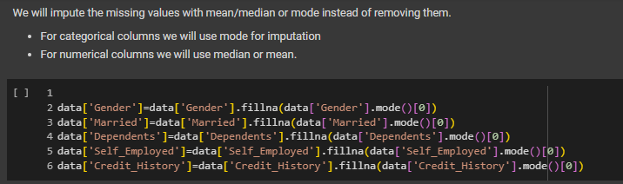
Importing and Cleansing the Data:
Importing necessary libraries
Loading data from its stored location
Data Cleansing
Checking important data information like missing values, duplicate values, so on.
Start cleansing data by either deleting missing values or imputing them, dropping unnecessary data columns, etc.
Statistical summary of data
Missing Data Handling
Handle missing data by imputing them with mean/median or mode (we use mode for categorical; median or mean for numerical).
Our data is skewed, so we impute the missing values with median.
Notes:
Import essential data analysis libraries: Pandas for data manipulation, NumPy for numerical operations, Matplotlib for plotting, and Seaborn for statistical visualization.

Slide 6
How the code works:
Overall, the code covers essential steps in building and evaluating machine learning models for loan approval prediction. It's a comprehensive approach that includes data preprocessing, model building, evaluation, and feature analysis
Model Building:
The dataset is split into independent variables (features) X and the dependent variable Y (target variable, Loan_Status).
Building a Decision Tree Classifier and a Logistic Regression model and KNN
Model Evaluation:
Evaluating model performance using various metrics such as confusion matrix, precision, and recall.
Feature Importance:
Analyzing feature importance using the feature importances provided by the Decision Tree Classifier and the coefficients provided by the Logistic Regression model.
The importance of each feature is visualized using bar plots to understand which features contribute the most to the model's predictions.
Visualization:
Various plots, including histograms, KDE plots, box plots, and bar plots, are used to visualize the distribution of numerical features, identify outliers, and understand the relationship between features and the target variables.
https://colab.research.google.com/drive/1PERP3jgPXXmuYPpEvqGkZsSpqqFZfMz8?usp=sharing

Slide 7
Desired Business Benefit for Stakeholders:
Strategic Overview
Utilizing AI for predictive loan approval modeling.
Leveraging historical customer data to improve accuracy in loan probabilities.
Stakeholder Benefits
Investors: Protects investments by minimizing financial risks.
Management: Reduces overhead and enhances profit margins through efficient operations.
Loan Officers: Prioritizes high-probability applications, optimizing workload.
Marketing Team: Develops targeted strategies based on predictive insights.
Profit Enhancement
Operational Cost Reduction: Automation cuts labor-intensive processes.
Lower Default Rates: Improved borrower assessment reduces defaults.
Increased Loan Disbursement: Efficient processing boosts successful applications and revenue.
Customer Satisfaction: Faster approvals and transparency improve loyalty and potential referrals.

Slide 8

Ethics of AI in Predictive Loan Approval
Transparency
Ensure AI decision-making processes and data influences are clearly communicated to borrowers.
Fairness
Audit AI systems to eliminate biases and implement fairness algorithms to guarantee equal opportunities.
Privacy
Comply with data protection laws and employ anonymization to protect applicant data.
Accountability
Define responsibilities for AI decisions and provide mechanisms for appeals and inquiries.
Inclusivity
Design AI to accommodate diverse populations and prevent economic disparities.
Reliability and Safety
Conduct extensive testing for AI model stability and manage unexpected behaviors effectively.

Slide 9



Project Roles:
Marksman- The implementer is the most important role for this project as the integration of new code that adds value comes mostly from using AI.
Spotter- The Business Analyst side is the second most important as seeing the added business value is very important for this project and can help us reach conclusions about what is working and what isn’t.
Gunsmith- The Data scientist is also an important role as the data handling and analysis is the basis of the results. Since the data itself comes from a third party source it is least important to analyze and more important to make it usable.

Slide 10
Implementing AI-Driven Loan Approval Automation at STAR House
Overview:
Context: STAR House, a financial institution, aims to automate loan approval processes to enhance efficiency, optimize resource utilization, and reduce financial risks.
Project Goal: Develop a predictive model using historical data to swiftly and accurately evaluate loan approval probabilities.
Implementation Strategy
Data Utilization: Use historical customer data (income, credit history, property details, etc.) to train the machine learning models that predict loan eligibility.
Models Deployed: Logistic Regression, Decision Tree, and K-NN algorithms to evaluate their effectiveness in predicting loan approvals.
Business Impact
Risk Mitigation: By automating the assessment process, the model prioritizes minimizing false positives (approving ineligible loans), thereby reducing potential financial losses.
Operational Efficiency: Streamlines the loan approval process, reducing the time and labor involved in manual assessments.
Customer Experience: Speedier loan processing improves customer satisfaction and trust in the financial services provided by STAR House.
Key Performance Indicators (KPIs)
Accuracy and Precision: Evaluate models based on their accuracy and precision, focusing on reducing false positives to prevent financial losses.
Processing Time: Measure the reduction in average time from loan application to decision before and after implementation.

Slide 11
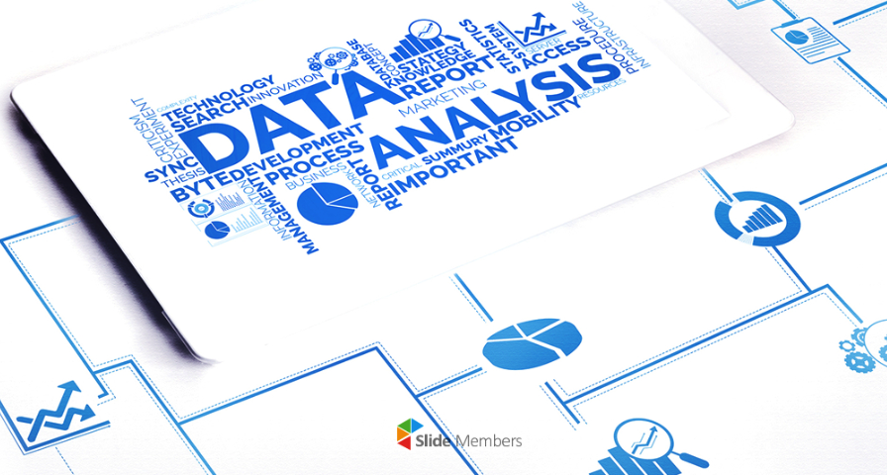
Exploratory Data Analysis - Notable Results:
Overall, around 69% of the people successfully get loan.
Considering gender, around 65% of male and female are successful in getting a loan.
Married people have a slight edge(around 5%) over the unmarried people in getting a loan.
Graduates have a slight advantage over the non-graduates in getting a loan.
Self-employed or not, everyone gets almost the same percentage of loans (65%)
People with bad credit history have a bad chance at getting a loan(<10%) whereas people with good credit history have a high success rate(>80%)

Slide 12
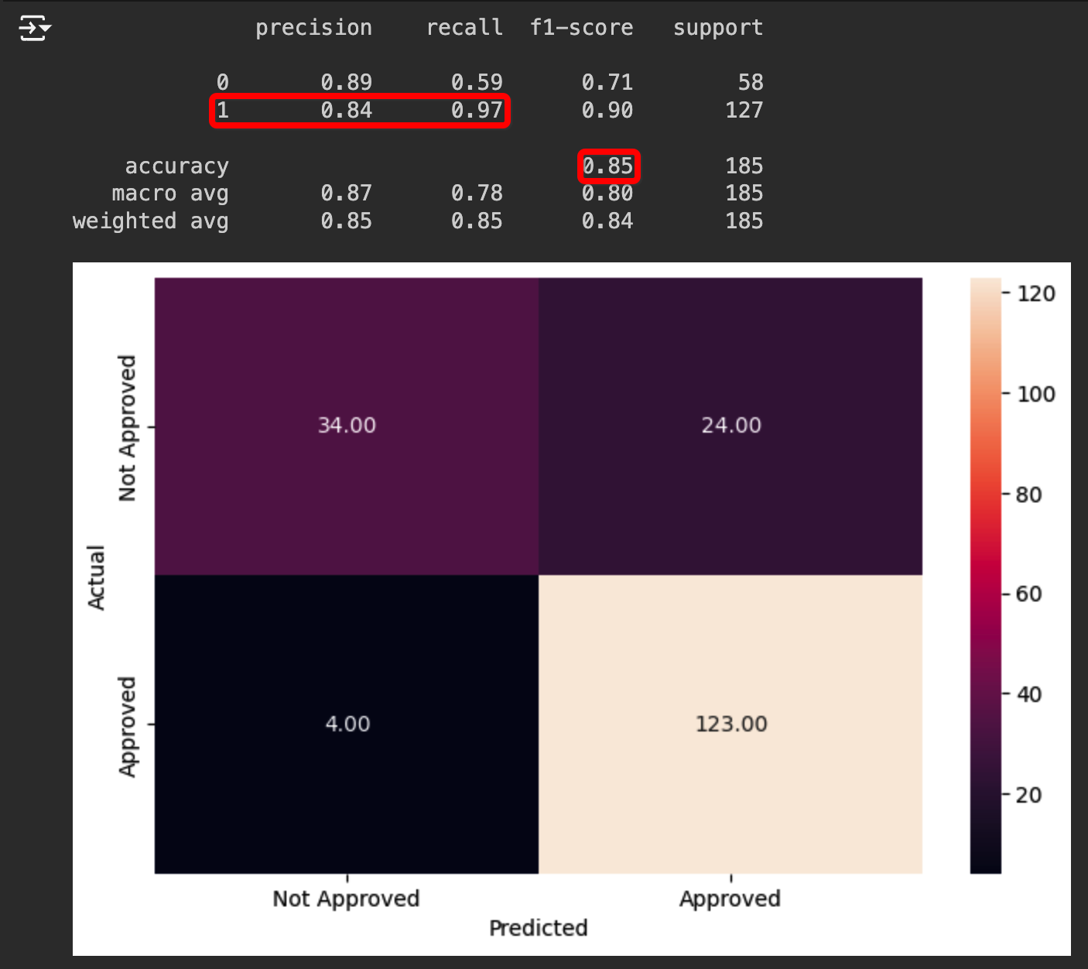
Results – Logistic Regression:
Results on Test Dataset (Untuned Model)
The model is giving 79% accuracy on train set while 85% accuracy on the test set i.e. the model is able to generalize well.
The precision and recall on test set is 84% and 97%.
The model can be further improved with hyperparameter tuning to improve the precision score.
Precision-Recall score will provide recall and precision score tradeoff with changing cutoff probability.

Slide 13
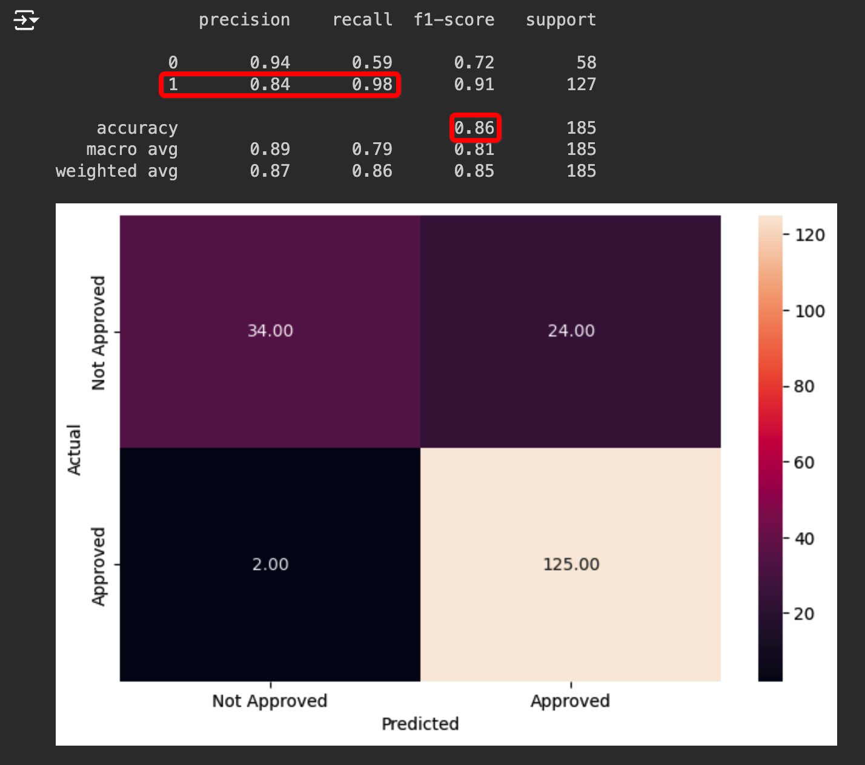
Results – Logistic Regression : Tuned
Results on Test Dataset (Tuned Model)
The model is giving 79% accuracy on train set while 86% accuracy on the test set, model has slightly improved by 1% on the test set.
The precision and recall on test set are 84% and 98%, recall has improved slightly better than untuned model.
Precision-Recall score will provide recall and precision score tradeoff with changing cutoff probability but at reduced accuracy score.

Slide 14
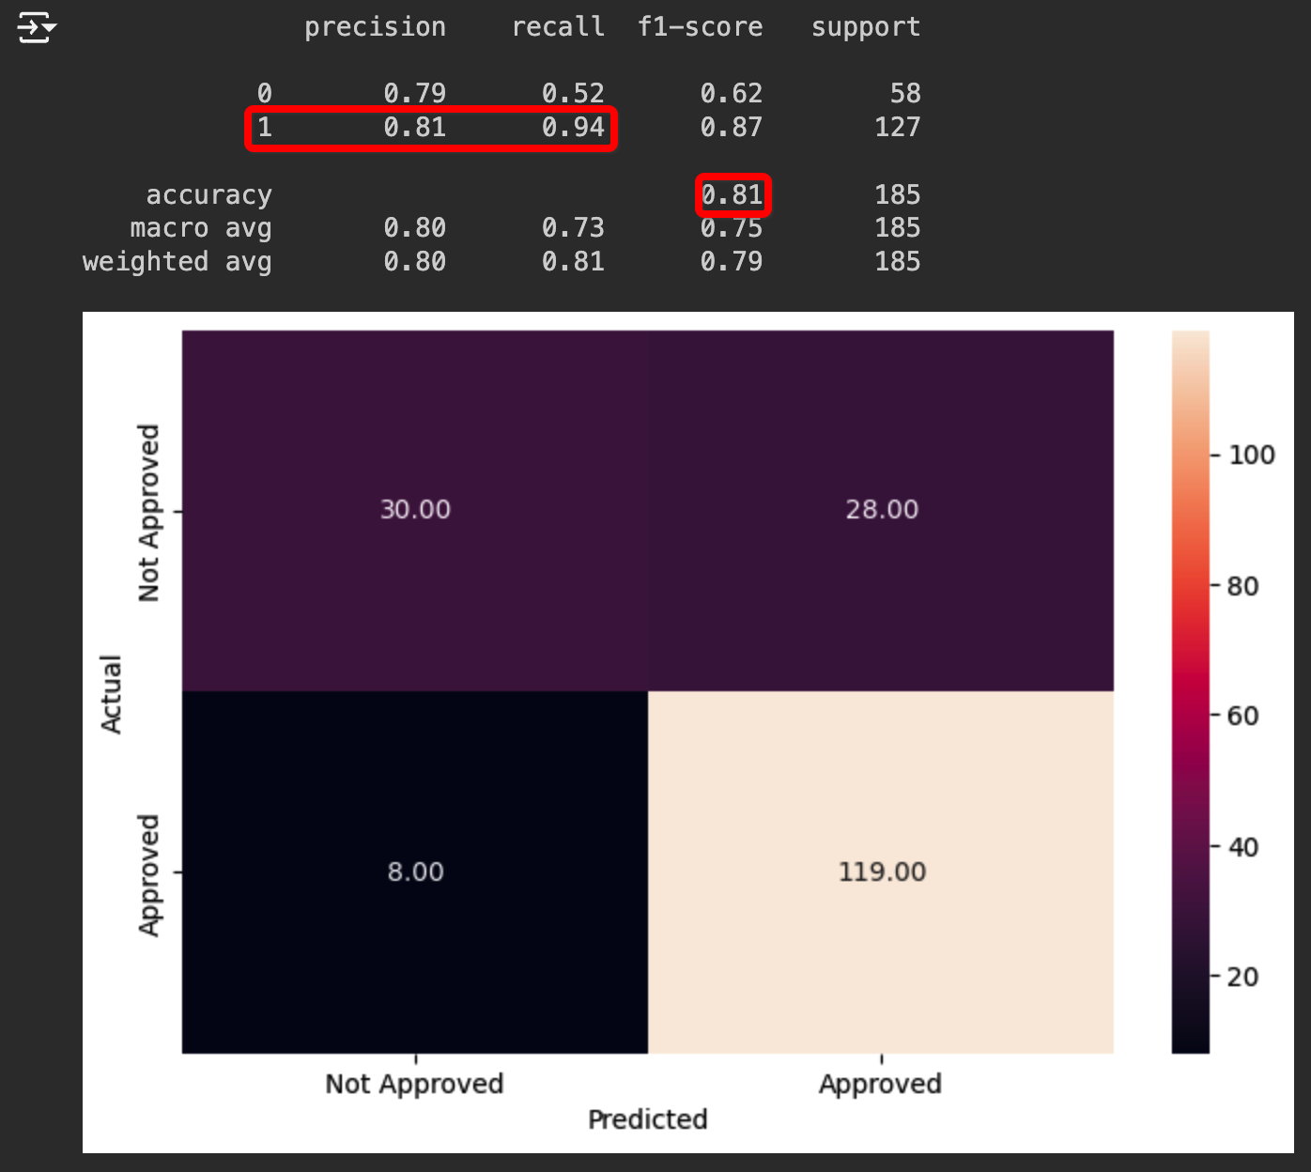
Results – K-NN:
Results on Test Dataset (Untuned Model)
We are getting an accuracy of around 81% on both test set and train dataset.
The recall for this model is 94% and precision is 81% on test data which is very good as we have still not performed any tuning on the models.

Slide 15
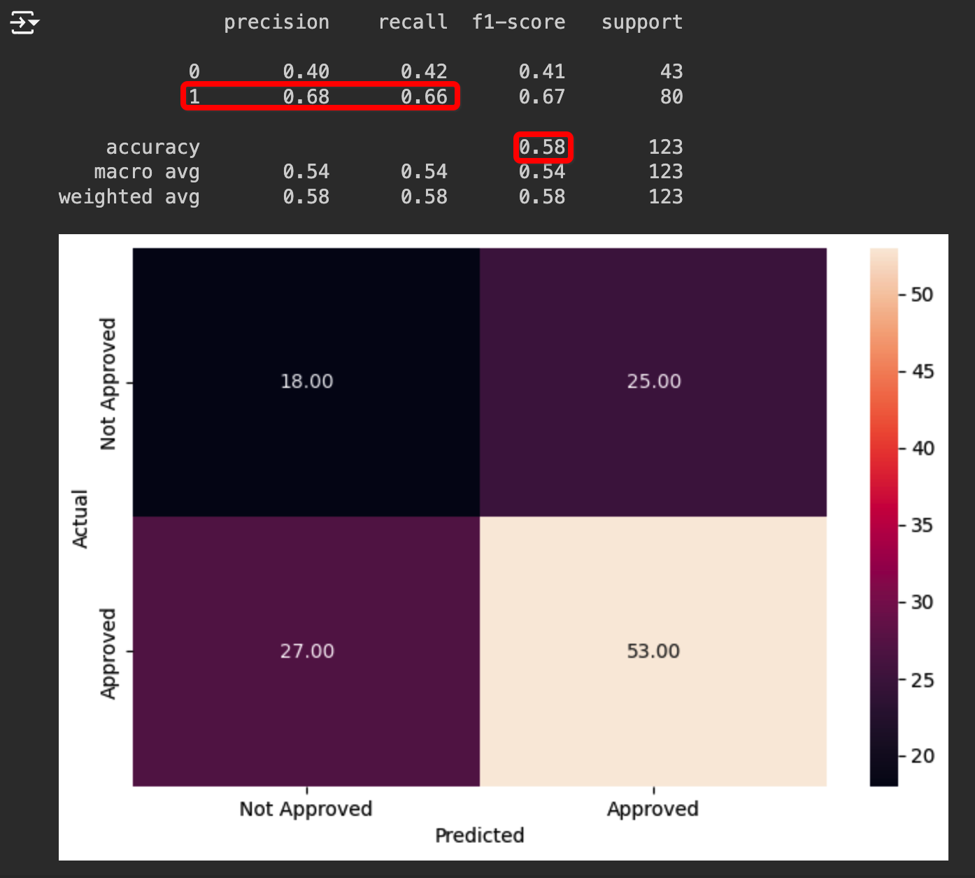
Results – K-NN : Tuned
Results on Test Dataset (Tuned Model)
After hyper parameter tuning, the model gives 58% accuracy on test data. Precision and Recall are at 68% and 66% respectively.
With hyper parameter tuning, the model's accuracy, precision, and recall reduced drastically. This suggests the model performs better before tuning.

Slide 16
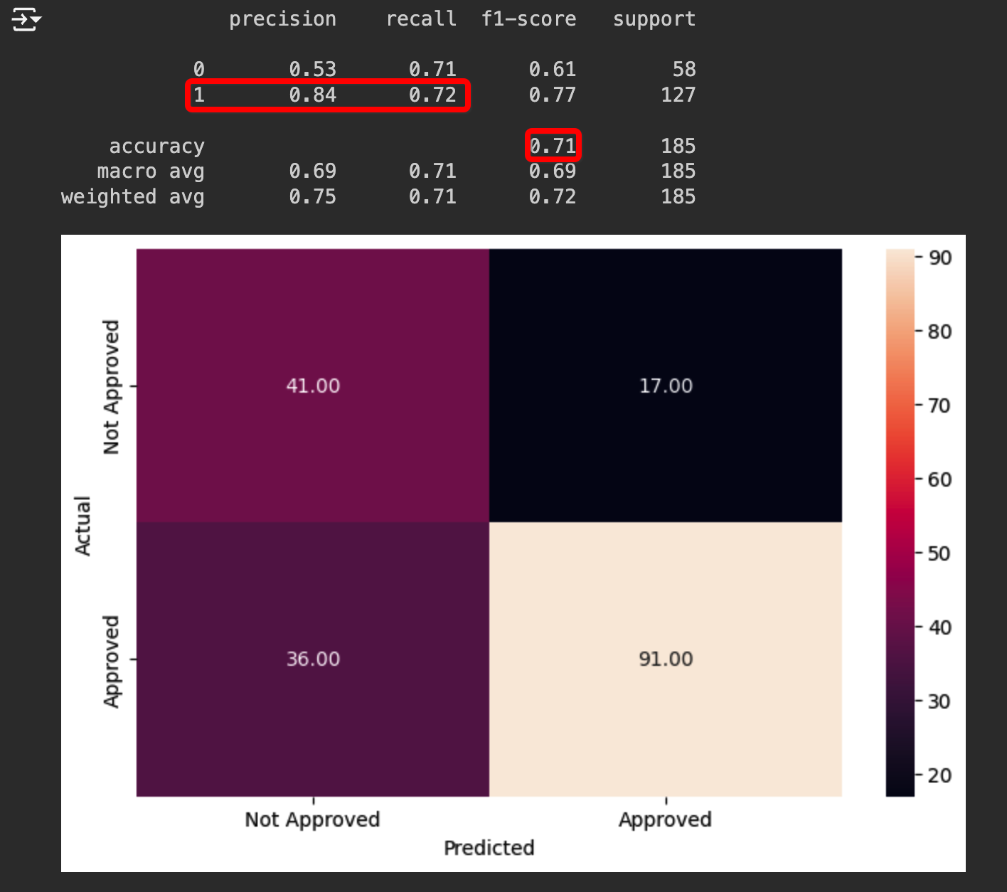
Results – Decision Tree:
Results on Test Dataset (Untuned Model)
The model is giving 100% accuracy on train set while 71% accuracy on the test set i.e. the model is overfitting.
The precision and recall on test set is 84% and 72%.
The model can be further improved with Hyperparameter tuning to avoid overfitting.

Slide 17
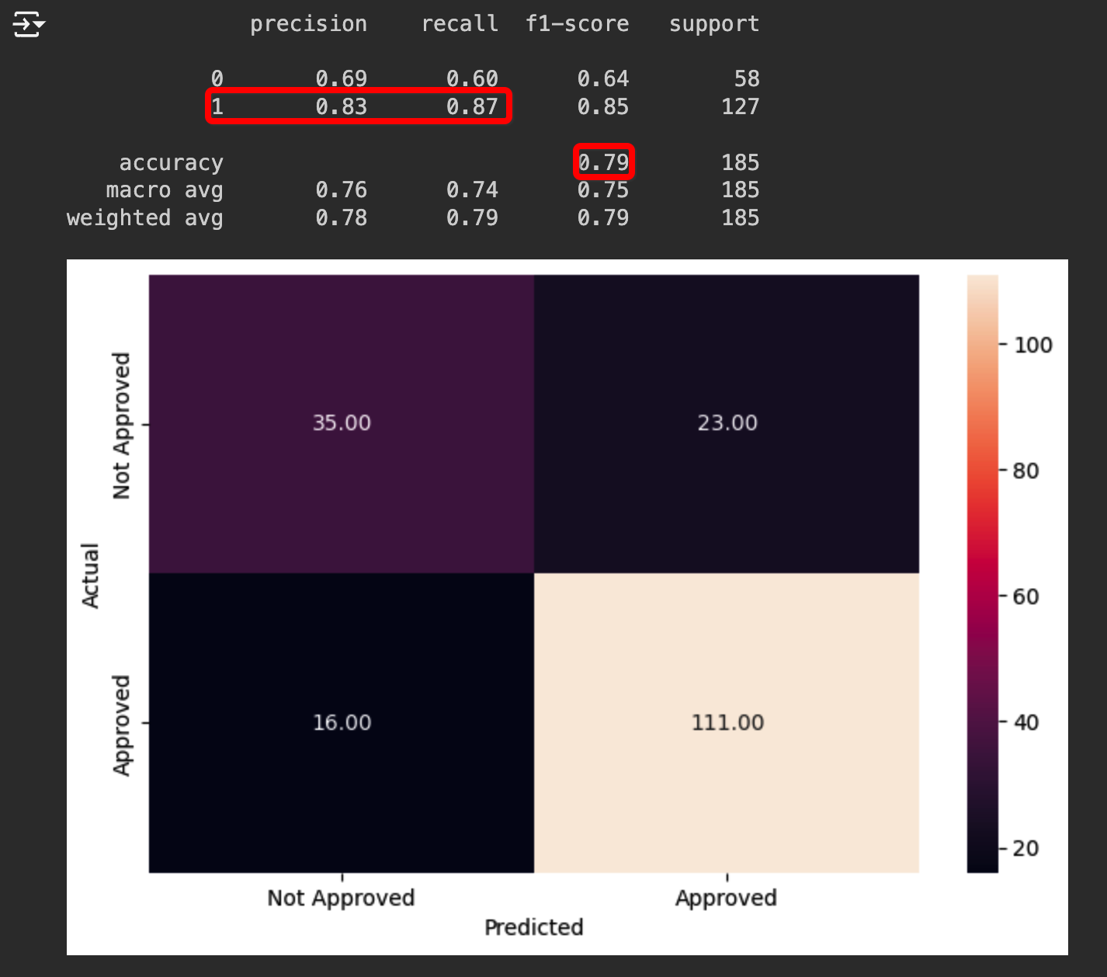
Results – Decision Tree : Tuned
Results on Test Dataset (Tuned Model)
With the tuned model we have a score of 79% on the test set.
With this, the model is forming better and can generalize.
Precision has slightly reduced to 83% from 84% while recall score has improved from 69% to 87%.

Slide 18
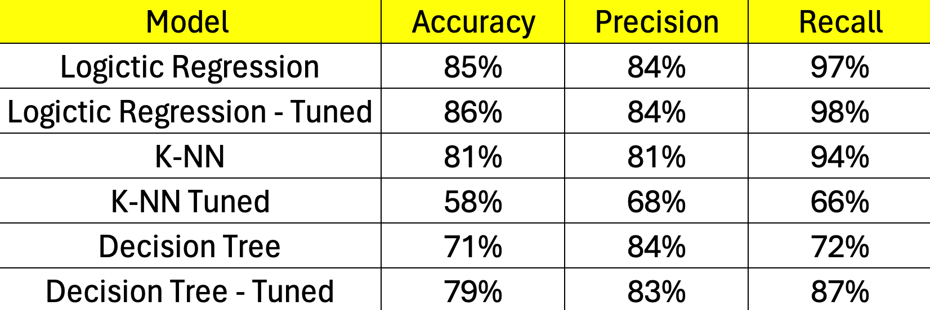
Conclusion:
Below Table gives performance comparison between Logistic regression, K-NN model and Decision Tree:
Logistic regression is performing better than K-NN model and Decision Tree on all parameters. Bank can use the Logistic Regression model to predict loan approval for new data set.
The Precision score achieved by all three models is similar except for K-NN Tuned model.
Feature Importances by Decision Tree is better for recommendations as they are more relevant and in line with actual bank procedures to approve actual home loans (than what pointed out by Logistic Regression model)
Decision Tree feature importance can help the bank in deciding the main factors affecting loan approval.

Slide 19

Recommendations:
Prioritizing Credit History: The bank should emphasize and prioritize an individual's credit history, as it serves as a significant indicator of their borrowing capacity, exemplified by credit scores.
Assessing Applicant's Income: It is imperative for the bank to focus on the income of the applicant when considering loan approvals. A consistent and substantial income facilitates smoother loan repayments.
Thorough Analysis of Loan Amounts: Approval of higher loan amounts necessitates meticulous scrutiny before sanctioning. The bank should carefully evaluate the risks associated with approving larger loan sums.
Filtering Applicants Based on Education: The bank should incorporate education background as a filtering criterion for loan applicants.
Considering Co-Applicant Income for Joint Loans: In cases of joint loans, the income of both applicants should be considered, as both parties share responsibility for repayment and ownership.
Emphasizing Properties in Semi Urban Areas: Properties located in semi urban areas should receive heightened attention compared to those in urban or rural areas.

Slide 20
THANK YOU

